Slide 1

Crafting impactful docs: The role of empathy in technical writing
Notes:
Good morning. So today we’re going to be talking about something a bit unconventional in a tech conference - we’re going to be talking about our feelings. In particular, empathy - and the vital role that it plays in crafting technical documentation that makes a deep and positive impact on its users of all backgrounds. From junior developers to sales professionals and more. But before we dive into our feelings today (yes, I’m not joking, this is really about our feelings) - who am I?

Slide 2




Who am I?
Senior Technical Writer
Kemi Elizabeth Ojogbede
+
Notes:
I’m Kemi Elizabeth Ojogbede, a Senior Technical writer at Upsun and Platform.sh. I have been in technical writing for about three years now, and before that I worked in data engineering, data management, content marketing and journalism. Both fluff journalism and political journalism.

Slide 3



Who am I?
BA Creative Writing
MA English Literature
MSc Data Science
Notes:
I have a masters degree in Data Science, another masters degree in English and a Bachelors degree in Creative Writing. The reason why proper technical documentation matters to me is because I have been on all points of the spectrum. Before I transitioned into Data Science and engineering, I came from a very non-technical background. Before I got my MsC in Data Science, I had a masters in English Lit and an Undergrad in Creative Writing. So when I had to work with API documentation in my first engineering roles, I was really surprised to see that lots of documentation assumed I didn’t need things explained to me. A lot of documentation does that actually. They assume to know the knowledge level of who they’re writing for, and tend to skim over things that may seem obvious.

Slide 4

Notes:
But who is it obvious to!? When I was first getting into engineering, there were a lot of things that I didn’t understand. Information about endpoints, authentication, parameters, and headers, as well as requests and responses, were completely devoid of examples, context and step-by-step breakdowns that would have saved me a lot of confusion and panic - all of which contributed to my imposter syndrome. I started feeling like maybe I wasn’t good enough or smart enough to be in tech, maybe my fascination with coding was simply linked to my obsession with The Matrix and Keanu Reeves when I was younger and that was it. Another thing is you don’t get a lot of people who look like me in this industry, so feeling like I was getting the proper help I needed from the documentation just made me feel like even more of an outsider. And I know I’m not the only one.

Slide 5
84% of developers use technical documentation to learn.
Of those, 90% use documentation found in API and SDK packages.
Stack Overflow Developer Survey, 2024
Notes:
So many developers rely on documentation at various stages of their learning processes. Stack Overflow data shows that a whopping 84% of developers use technical documentation to learn, with pretty much a majority of them using API and SDK package docs for their projects. These are developers who perhaps may need guidance on which parameters they should include, the proper syntax for a GraphQL filter API, how to understand the structure of a schema, or how to request an ID for their repository. These are people who are contributing to Open Source projects as a way to build their confidence in coding.

Slide 6
Despite documentation being highly valued in Open Source communities, incomplete or confusing documentation is a leading issue for most Open Source software users.
Open Source Developer Survey
Notes:
And what they’re finding is documentation that is incomplete or confusing. It’s a growing issue not just in Open Source communities but in the tech industry all over. We write based on the assumption that our readers will “just get it”

Slide 7
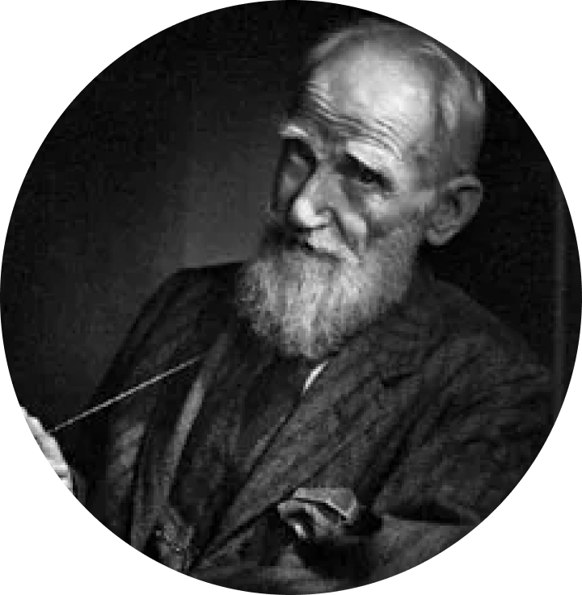
“The single biggest problem with communication is the illusion that it has taken place.” George Bernard Shaw
Founder of the London School of Economics
Notes:
But that’s the problem. How do we know that people will get what we’re trying to say? This is an issue that has been prevalent since people have been communicating. And George Bernard Shaw, who is a Nobel Prize Winner for Literature, said it best: “The single biggest problem with communication is the illusion that it has taken place”.

Slide 8
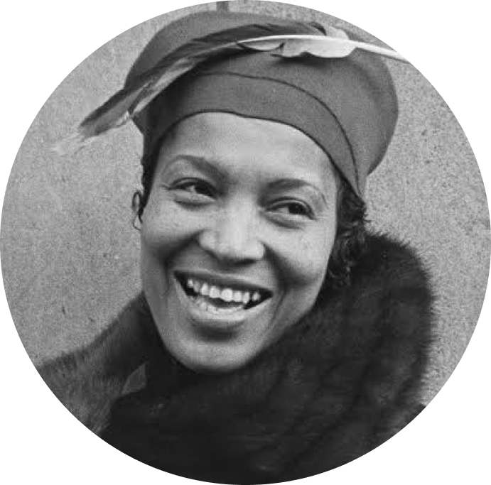
“There’s no use talking [writing] unless people understand what you say.” Zora Neale Hurston
World-renowned writer and anthropologist
Notes:
If you want to take it one step further, even Zora Neale Hurston - the author of one of my favourite books, Their Eyes were Watching God - said: There’s no use talking or writing unless people understand what you say.

Slide 9
How do we create documentation that truly helps users?
Notes:
So, with all of that being said - How do we create technical documentation that truly helps users from all walks of life and all levels of technical knowledge? *drum roll please*

Slide 10

Notes:
It’s simple, we’ve got to use our emotions. I did warn you, I did say that we’d be talking about our feelings today. But in particular, the one emotion I’m talking about is EMPATHY. The act of putting ourselves in the shoes of others and seeing things from their perspective. Allowing ourselves to step out of our own experiences to see how technical documentation could be perceived by different readers. So, how do we do that?

Slide 11

Notes:
Well, first, before we even begin writing the documentation, we have to be curious about who we’re writing it for. Personally, I like to imagine that someone has asked me to bake a cake. Now, if someone asked me to bake a cake, I could just bake the cake that’s easiest to make - but what if they’re allergic to one of the ingredients? What if they don’t like that flavour? What if they wanted red velvet instead of carrot? What if it tastes downright disgusting to them? That’s why if someone asks you to bake a cake, you ask them QUESTIONS: what flavour do you want? What colour do you want the cream? Are you allergic to nuts?

Slide 12
Questions are how we connect to people.
It’s how we understand where they’re coming from.
Notes:
Similar to this: We should always ask questions about our users to understand how we can best meet their needs with our documentation. Questions ultimately are how we can connect with people and understand where they’re coming from. And that’s the true essence of empathy - going that extra mile to make people feel seen, heard and considered.

Slide 13
Who am I writing for?
Notes:
So, two questions that I personally think are great to start of with are: “who am i writing for” and “how complicated is this topic?” First off, who are you writing for? While the answer to this can be really broad, a way to make it more specific is instead ask:

Slide 14

Why would someone read this?
Notes:
“Why would someone read this?”, this allows you to understand the scenarios and use cases that a reader might need your documentation for, and this question can even help you come up with examples and code snippets that you can use to demonstrate certain steps that may be a bit more complicated.

Slide 15
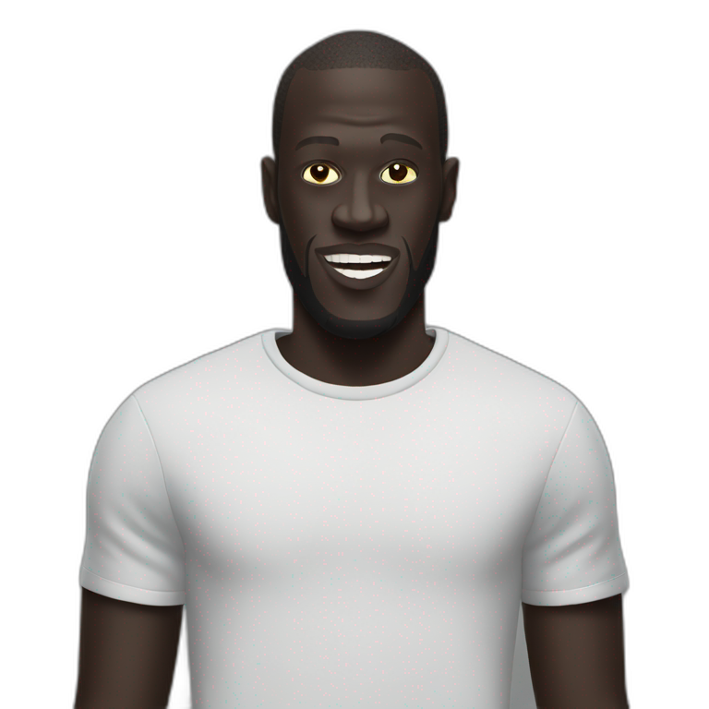
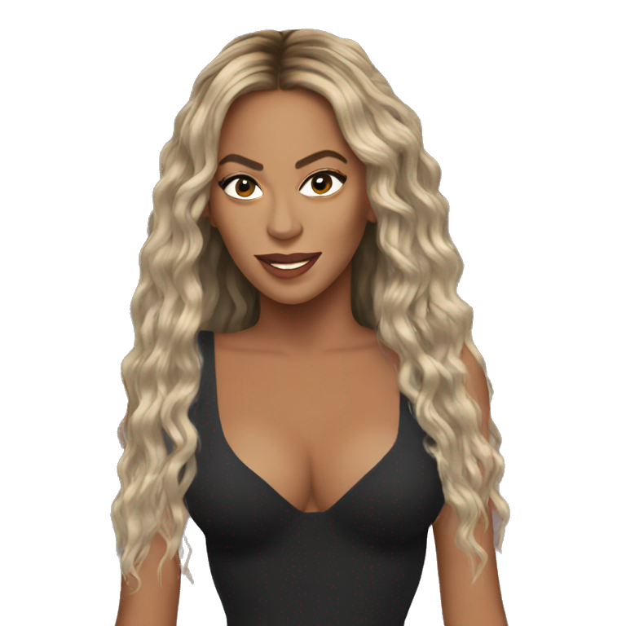
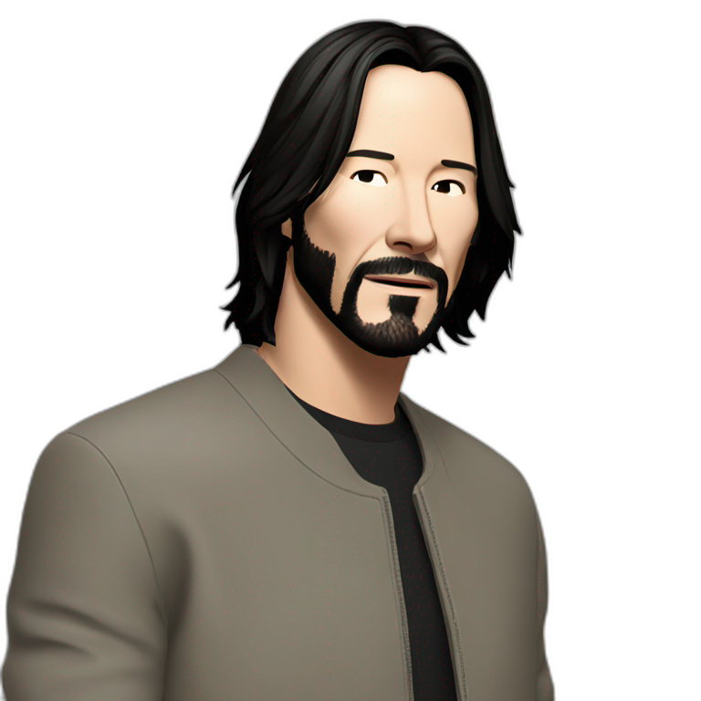

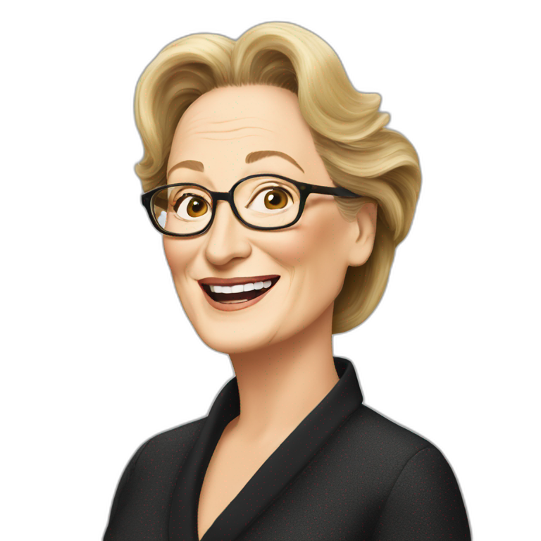
Priyanka Chopra:
Machine learning engineer
Keanu Reeves: Tech recruiter
Stormzy: Marketing analyst
Meryl Streep:
Junior product manager
Beyoncé:
Full stack developer
Notes:
A key way to determine who you’re writing about is to develop personas for who might want to read your documentation and what each of their use cases would be. For example, if we were looking at API documentation, we could have:
Beyonce: a full stack developer who is scanning the docs for how to get the access token to authenticate her request.
Keanu Reeves: a tech recruiter who is trying to find information about the types of APIs we use so he can inform a potential junior developer candidate of their day-to-day tasks in a first stage interview.
Stormzy: A marketing analyst who has never used APIs before but needs a JSON containing content for his client.
Priyanka: A machine learning engineer who is trying to build a chatbot trained on API documentation.
Meryl Streep: A junior product manager who is working on a new API and needs information about existing APIs so she can understand what the engineers are talking about in the daily stand ups.
All of these personas are at different levels of understanding and technical knowledge, but being aware of their possible use cases would help us decide how we can be generally useful and comprehensible to most if not all of them.

Slide 16
How complicated is this topic?
Notes:
The next question is: how complicated is this topic? And if you can’t really determine how complicated the topic you’re writing about is, try and think of how you would explain it to a beginner.

Slide 17

How would I explain this to a beginner?
Notes:
One of my favourite phrases to use when anyone is explaining a concept to me is: explain to me like i’m five years old. If you feel like you would struggle a lot to explain it to a toddler, a non-technical person or a complete beginner in this topic, then that can guide you in how in-depth you need to go with your explanation. Maybe you’ll need diagrams, maybe you’ll need more examples, maybe you need to explore the use of screenshots, videos and gifs to demonstrate a certain process for visual learners - use every educational tool at hand so you can effectively help your reader.

Slide 18



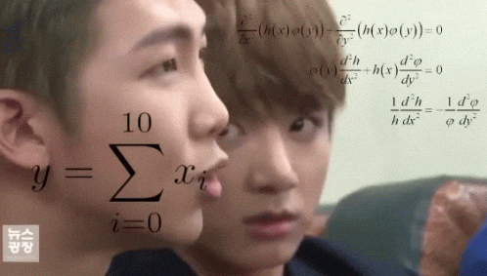


Notes:
These questions are just some of the initial steps we can take to help us become more empathetic writers when crafting documentation for our users. The fact that we’re already prefacing the documentation with knowledge of who we’re writing for and how we can explain complex concepts effectively means we’re already on our way to preventing our documentation from being confusing, presumptuous and unhelpful. At the end of the day, we want our documentation to give people the answers they need, instead of leaving them with more questions than they came with.

Slide 19


Get into your feelings:
5 questions to help you empathize with all readers
Notes:
Now I’m going to break down 5 easy ways in which we can use empathy to enhance the learning experience for our potential readers.

Slide 20
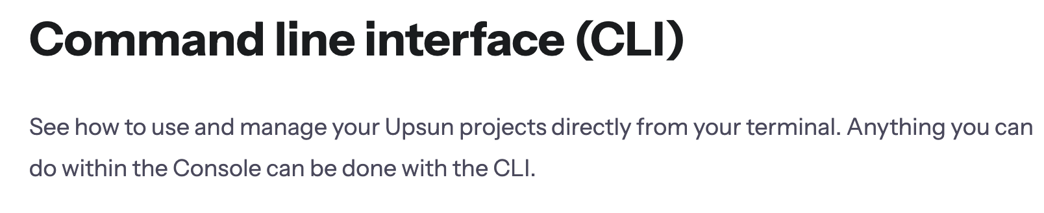
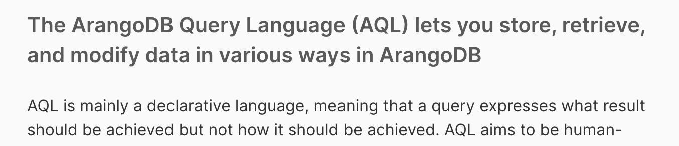
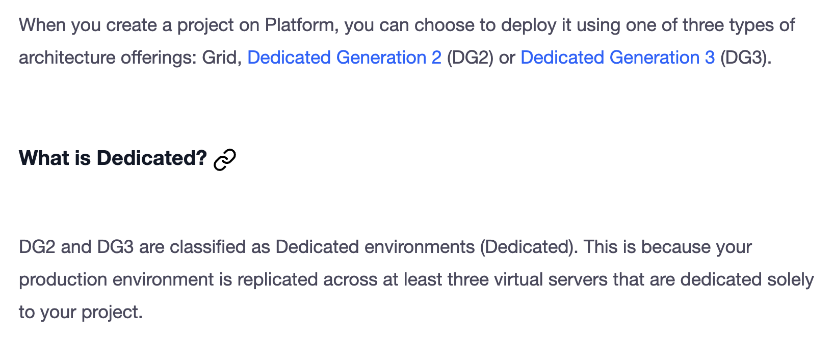
One
Will the reader understand my abbreviations?

Slide 21
Two
Have I used enough examples?
Deeper insight into how easily readers can implement your instructions
Practical and realistic scenarios that encourage the reader to try things out independently

Slide 22
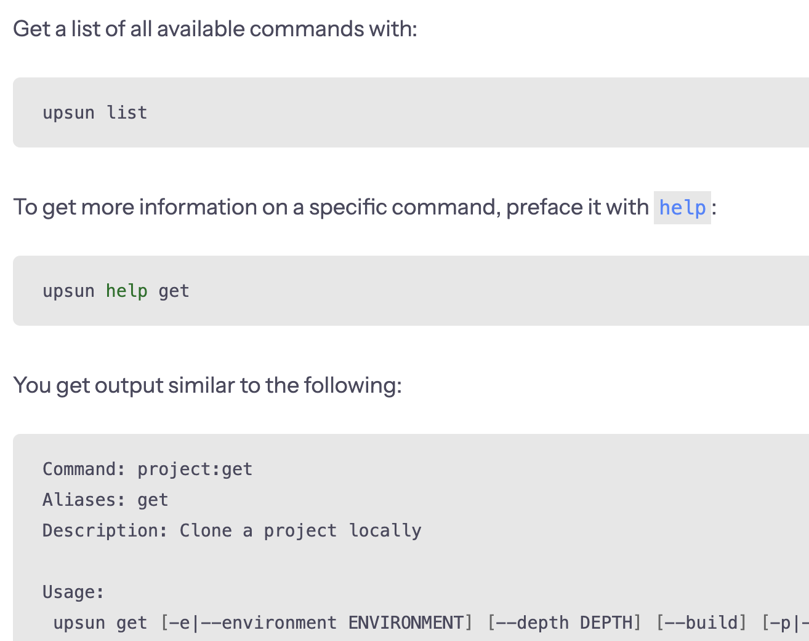
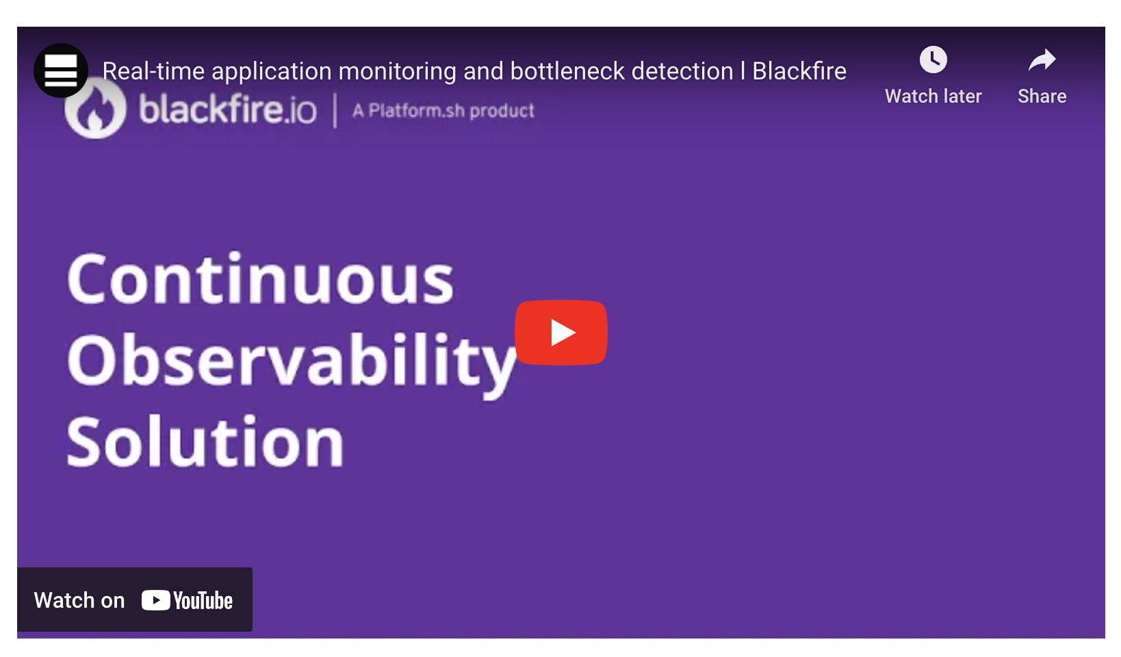
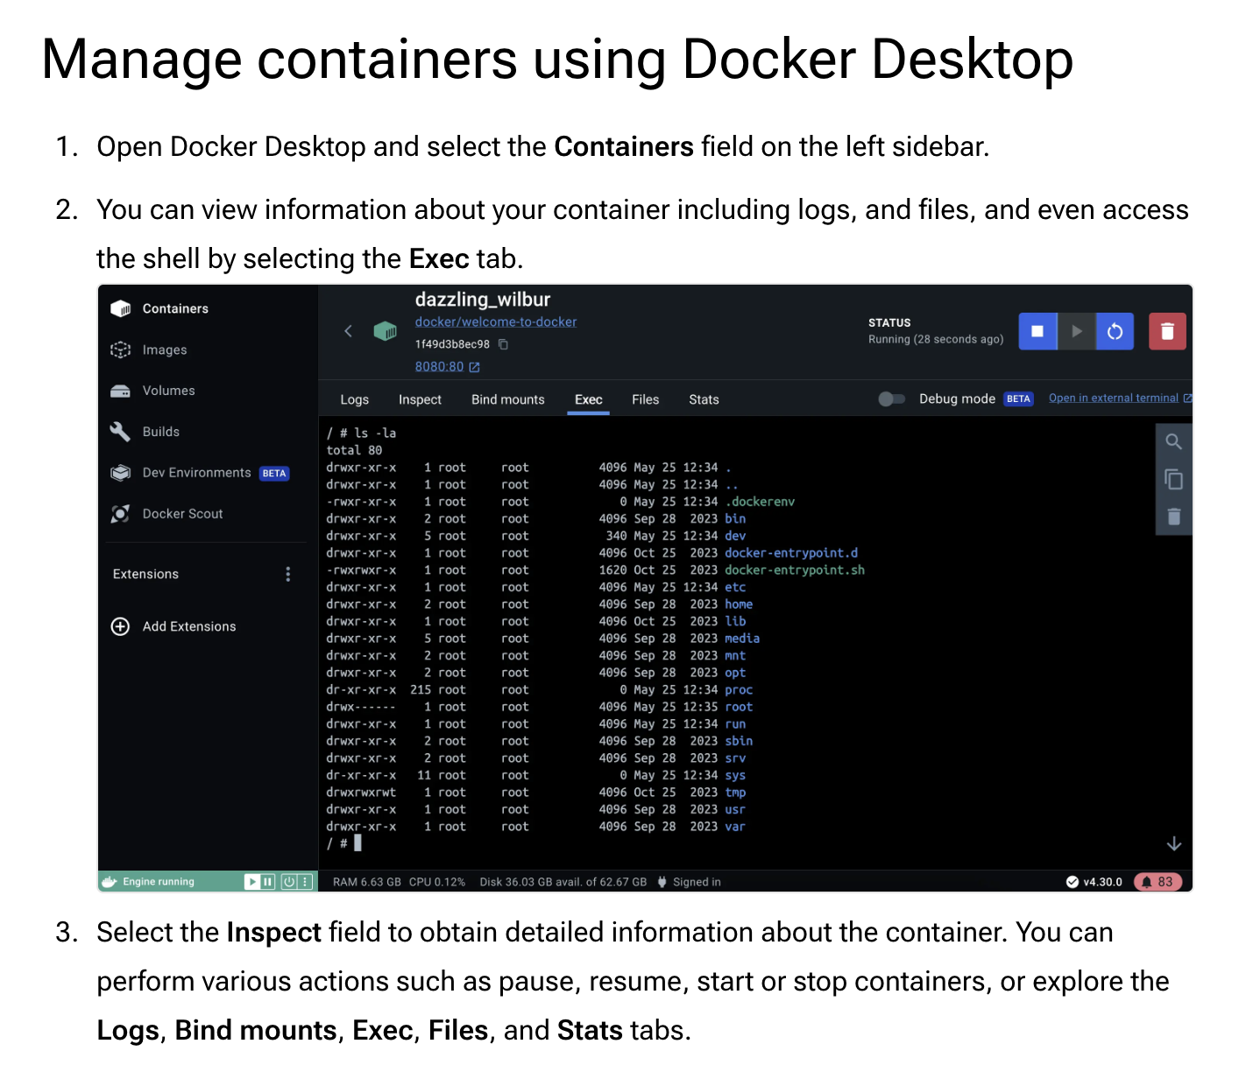
Three
Am I catering to all kinds of learners?

Slide 23
Four
Can everyone understand the words I’m using?
Simplifying your syntax ensures you don’t exclude people who aren’t native speakers of the language you’re writing in.
Cutting jargon allows you to get straight to the point.

Slide 24
Five
Is my documentation accessible and inclusive?
DO: Use alt-text and captions for images and descriptive link text for those using screen readers
DON’T: Use gender specific or ableist language
DO: Ensure users can navigate using just the keyboard

Slide 25
Bonus
More questions to consider …
Can this be simpler?
Is this up to date?
Is it easy to find more information?
Have I provided enough context?
Is this easy to follow?

Slide 26
In conclusion…
Get curious:
Ask questions about your readers
Get creative:
Create personas and use-cases for your readers
Get out of your head:
No blind assumptions about your readers

Slide 27


Slide 28
Kemi Elizabeth Ojogbede

